Slide 1
ICT4D Social Media For Development (SM4D)

Slide 2
Social Media
Definition and Meaning

Slide 3
Social Media: Definition
Social media are interactive technologies that facilitate the creation and sharing of information, ideas, interests, and other forms of expression through virtual communities and networks.
Websites and applications that enable users to create and share content or to participate in social networking.
Social media is a group of Internet based applications that build on the ideological and technological foundations of Web 2.0, and that allow the creation and exchange of user-generated content
Platforms that provide users the ability and tools to create and publish their own mini web sites or web pages
Social media is an ever-growing and evolving collection of online tools and toys, platforms and applications that enable all of us to interact with and share information. Increasingly, it’s both the connective tissue and neural net of the web.

Slide 4
Mass Media Vs Social Media
Mass Media
Print Media: Newspaper, Magazine, Journals, Pamphlets
Electronic Media: TV, Radio, Online News sites
Features
One to many( broadcast); centralised; capital intensive; mostly run by corporates
content predominantly produced by professionals and/or professional media companies.
Social Media
Media using Internet and Web 2.0
Facebook, You tube, Twitter, WhatsApp, Instagram, Pinterest
Many to many; decentralised; can be started with low cost; big platforms are mostly run by corporates but contents are generated by users

Slide 5
*what do people do when in social media?
music and movies are the most popular activities among those who participate in social networks
China (86%), India (85%), Mexico (84%), Greece (83%), Turkey (78%), Tunisia (77%) and Italy (75%)
for expressing political views and community issues
product research, collaborative research
religion is not a particularly popular topic among users of social networking. Only about a third or less have posted on religion in 14 countries in the study. The exceptions were Egypt (at 63%), Tunisia (63%) and Jordan (62%).
Men are more likely to use social media for business or dating. Women are more likely to use social media for relationships, sharing, entertainment and self-help.
*The Pew Research Center’s 2012 Global Attitude Project

Slide 6
Social Media
Types: Categorisation

Slide 7
Types of Social Media
Social network sites (SNS) or social networking sites
“web-based services that allow individuals to: (1) construct a public or semi-public profile within a bounded system; (2) articulate a list of other users with whom they share a connection; and (3) view and traverse their list of connections and those made by others within the system.”
Facebook, YouTube, WhatsApp, Instagram, WeChat, TikTok, Sina Weibo, LinkedIn
Blogs (web logs)
Wix, WordPress, Weebly, Medium , Ghost , Blogger , Tumblr
Wikis
A wiki “is a piece of server software that allows users to freely create and edit web page content using any web browser.”
Wikipedia, “a collaboratively edited, multilingual, free Internet encyclopaedia”
Podcasts (iPod and Broadcast) and webcasting (broadcasting over the Internet)
A podcast is a program made available in digital format for download over the Internet
Software: mp3 audio, RSS(Really Simple Syndication) feed, XML-formatted file
For example, an episodic series of BBC world news that a user can download to a personal device to listen to at a time of their choosing

Slide 8
Types of Social Media-2/2
Forums
online discussion sites where people can hold conversations in the form of posted messages
Topics are organized into threads that anyone can start
Reddit, Quora, Stack Overflow, XDA-Developers, GamesSpot, Volconvo, Perspectives
Content communities
a group of people with common interests who come together for the purpose of creating, sharing, and consuming content
YouTube, Flickr, Facebook Groups, LinkedIn, Twitter, Pinterest, Quora, Reddit , Medium, Slack Groups.
Social Network Game
Green Patch, Happy Farm, Mob Wars ,FarmVille, Mafia Wars, Kantai Collection, The Sims Social
Microblogging
“is the practice of posting small pieces of digital content—which could be text, pictures, links, short videos, or other media—on the Internet”
Twitter, Koo, Tumblr, Plurk, Twister, Gab , Micro.blog and Sina Weibo

Slide 9
Social Media
Features/Characteristics

Slide 10
Features of Social Media
Participation:
Social media encourages contributions and feedback from everyone who is interested. It blurs the line between media and audience.
Openness
Most social media services are open to feedback and participation. They encourage voting, comments and the sharing of information. There are rarely any barriers to accessing and making use of content, and password-protected content is frowned on.
Unfiltered Information
Conversation
Whereas traditional media is about “broadcast, social media is better seen as a multi-way conversation.
Community Building
Social media allows communities to form quickly and communicate effectively. Communities share common interests, such as a love of photography, a political issue or a favourite TV show.
Level playing field- making the world flat
Counter-hegemonic

Slide 11
Social Media
As a Development Tool

Slide 12
Developmental capabilities of Social Media
Facilitate, even fortify, the culture of networking
Help build social capital
Provide open and equal access to information, market, Government service, opportunities, advantages
Give voice to marginalised disadvantaged people
Empower local communities, women, and marginalised people
Encourage Innovation, collaborative endeavour
Encourage content creation by anyone, anywhere, anytime
Make citizen aware, promote civic culture
Fastest and least costly way to launch new product, services, ideas, innovations

Slide 13

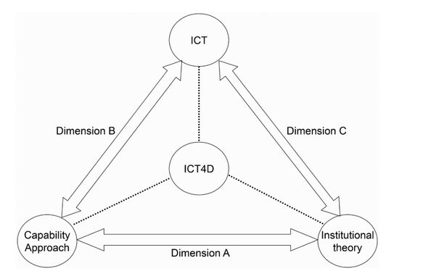

Slide 14
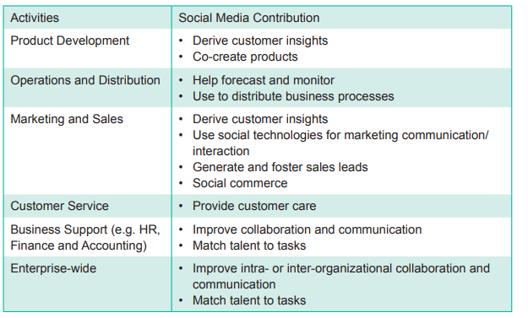

Slide 15
Social Media for Development-1/2
Rural Development
decision-making process; market outlook; empowering rural communities; targeting marginalized groups; participatory development, and creating employment
Environmental Protection
Political Coordination and mobilisation
All political parties use SM for awareness, building narrative, opinion, campaigning
Cambridge Analytica scandal: using SM profile/data for political messaging
Social Movements
Social media was used extensively for Farmer’s movement, NBA, Lokpal,etc.
Education
You Tube, Zoom, Google Meet, Telegram, Blogs, Wikis, podcast
Edtech companies using Social Media for online education
Google Classroom; Classroom Salon; Open Study( more like private telegram group)

Slide 16
Social Media for Development-2/2
Public Health
one fact sheet or an emergency message about an outbreak can be spread through Twitter faster than any influenza virus
can be used to teach patients and communities about low-cost interventions that could benefit their health.
create a community to better share health-care knowledge and practices.
Combatting Corruption
citizens report corruption through social media
Naming & Shaming
“I Paid a Bribe”; India against Corruption“(India);Bribe Nigeria”; “Not Here”(Uganda); “Chanjo Project”(Tanzania)
Disaster Risk Reduction
Timely information, relief & rescue, safety info of near & dear ones
Crowdsourced disaster response
History and culture preservation
Accountability
People as watchdog

Slide 17
Social Media
Minuses and Challenges

Slide 18
Social Media – Challenges & Issues
Socio-economic Issues
Access, affordability, knowledge deficiencies
Governance Issues
Policy gap, legal issue, toleration
Issues related to nature of SM
Rumour, fake news, and Defamation
Privacy & Security
Fraud, Identity theft
Social Media as Time Suck
Addiction
Cyberbullying and hate speech
Catfishing

Slide 19
THANKS FOR LISTENING!
BE SAFE …GOOD WISHES !

